Slide 1

Algebra 1
Unit 1, Lesson 9 Adding and Subtracting Radical Expressions Volume 1, pg. 45

Slide 2


Benchmark
MA.912.NSO.1.4
Apply previous understanding of operations with rational numbers to add, subtract, multiply, and divide numerical radicals.
volume 1, pg. 45

Slide 3
Integrated Mathematical Thinking and Reasoning Standards
MA.K12.MTR.2.1 Demonstrate understanding by representing problems in multiple ways.
MA.K12.MTR.4.1 Engage in discussions that reflect on the mathematical thinking of self and others.
MA.K12.MTR.5.1 Use patterns and structure to help understand and connect mathematical concepts.
volume 1, pg. 45

Slide 4

Learning Target
I can add or subtract two square roots or two cube roots.
volume 1, pg. 45

Slide 5

Warm-Up
volume 1, pg. 45

Slide 6
1.9.1 Warm-Up: Adding and Subtracting Algebraic Expressions
Find the sum or difference of each algebraic expression.
Complete the statement to explain why is it possible to combine the terms in each of these expressions.
When adding and subtracting algebraic expressions,
_________ terms can be combined.
$$4x+23x$$ | $$−7t−40t$$ | $$−35b+10b$$
volume 1, pg. 45
Notes:
Video Link: https://algebranation.wistia.com/medias/fi4fidi5y8

Slide 7
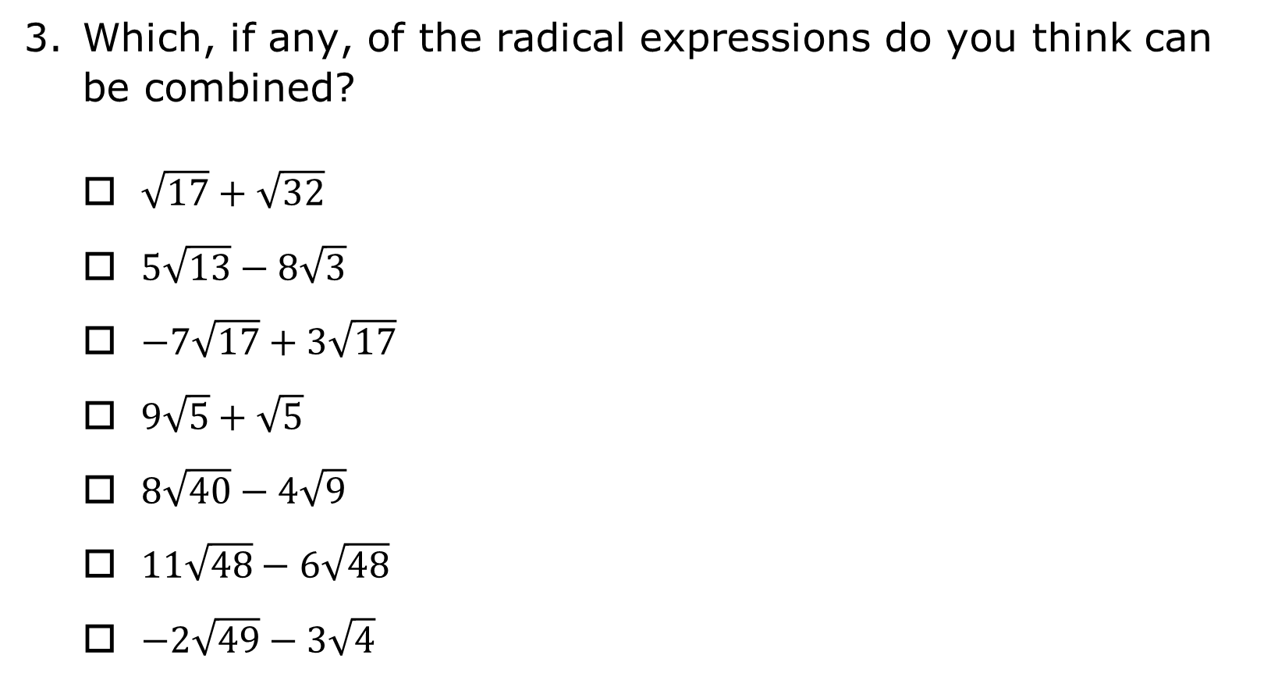
Which, if any, of the radical expressions do you think can be combined?
$\sqrt{17}+\sqrt{32}$
$5\sqrt{13}−8\sqrt{3}$
$−7\sqrt{17}+3\sqrt{17}$
$9\sqrt{5}+\sqrt{5}$
$8\sqrt{40}−4\sqrt{9}$
$11\sqrt{48}−6\sqrt{48}$
$−2\sqrt{49}−3\sqrt{4}$
volume 1, pg. 45

Slide 8

Exploration
volume 1, pg. 46

Slide 9

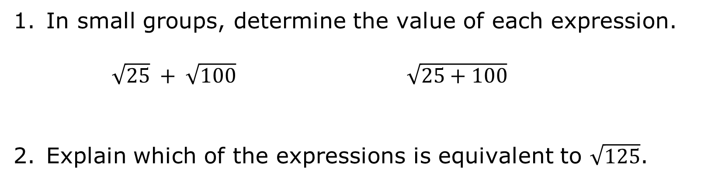
1.9.2 Exploration: Adding and Subtracting Radical Expressions
In small groups, determine the value of each expression.
$\sqrt{25} + \sqrt{100}$ $\sqrt{25+100}$
Explain which of the expressions is equivalent to $\sqrt{125}$.
volume 1, pg. 46

Slide 10
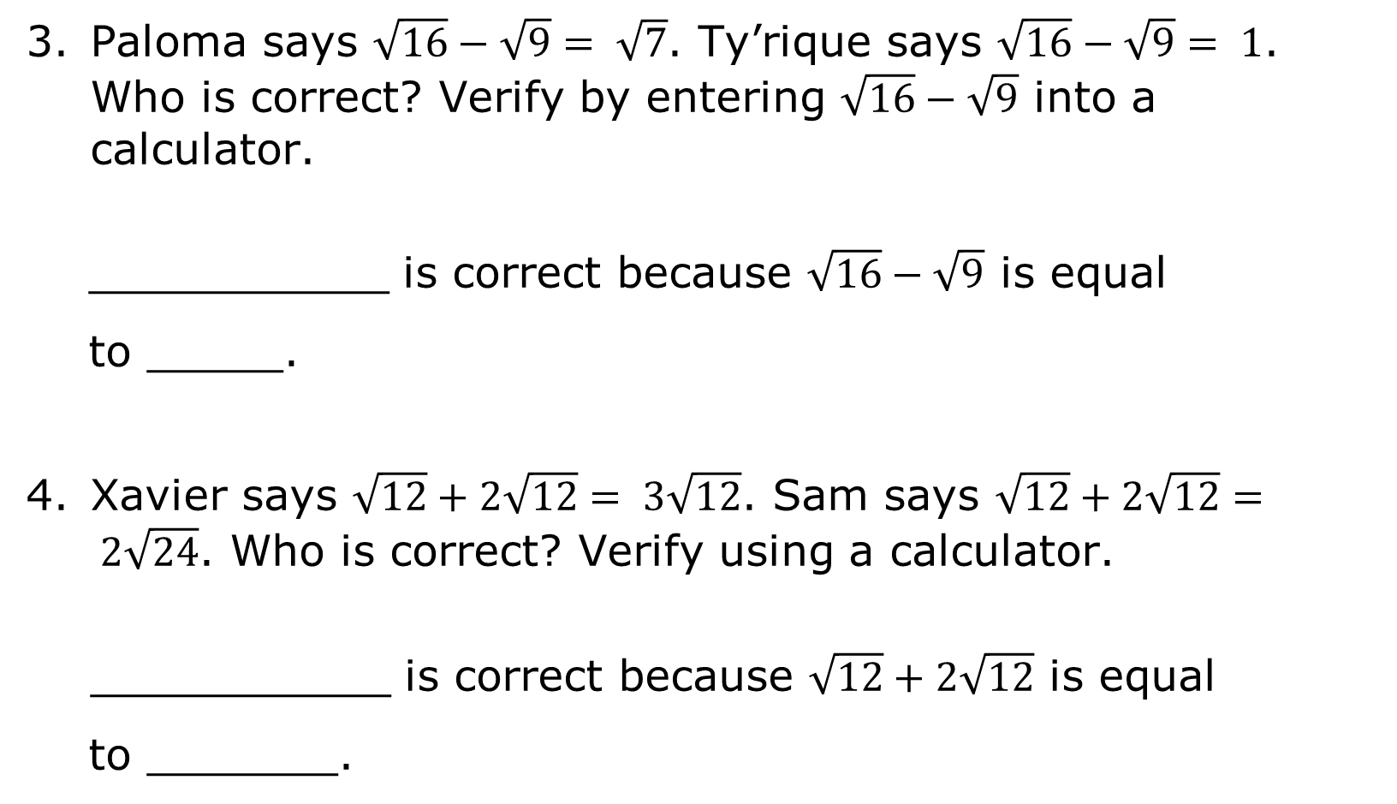
Paloma says $\sqrt{16}−\sqrt{9}= \sqrt{7}$. Ty’rique says $\sqrt{16}−\sqrt{9}= 1$. Who is correct? Verify by entering $\sqrt{16}−\sqrt{9}$ into a calculator.
___________ is correct because $\sqrt{16}−\sqrt{9}$ is equal to _____.
Xavier says $\sqrt{12}+2\sqrt{12}= 3\sqrt{12}$. Sam says $\sqrt{12}+2\sqrt{12}= 2\sqrt{24}$. Who is correct? Verify using a calculator.
___________ is correct because $\sqrt{12}+2\sqrt{12}$ is equal to _______.
volume 1, pg. 46

Slide 11

Guided Instruction
volume 1, pg. 46

Slide 12


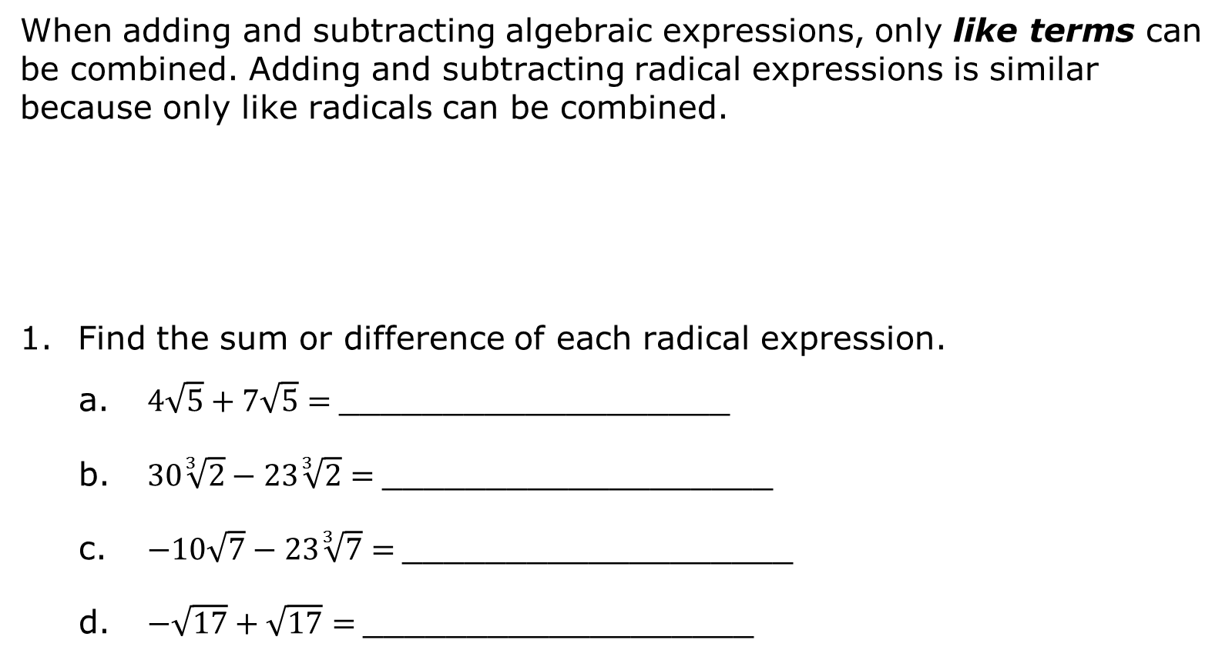
1.9.3 Guided Instruction: Adding and Subtracting Radical Expressions
When adding and subtracting algebraic expressions, only like terms can be combined. Adding and subtracting radical expressions is similar because only like radicals can be combined.
Find the sum or difference of each radical expression.
$4\sqrt{5}+7\sqrt{5}=$___________________
$30\sqrt[3]{2}−23\sqrt[3]{2}=$___________________
$−10\sqrt{7}−23\sqrt[3]{7}=$___________________
$−\sqrt{17}+\sqrt{17}=$___________________
Like radicals are radical terms that have the same index and the same radicand.
volume 1, pg. 46

Slide 13
Three steps can be used when adding and subtracting radical expressions.
Step 1: Find perfect squares (for square roots) or perfect cubes (for cube roots) that are factors of the radicand.
Step 2: Rewrite the radical expressions by applying the product law of radicals and evaluating any perfect squares or cubes.
Step 3: Add or subtract like radical terms.
volume 1, pg. 46

Slide 14
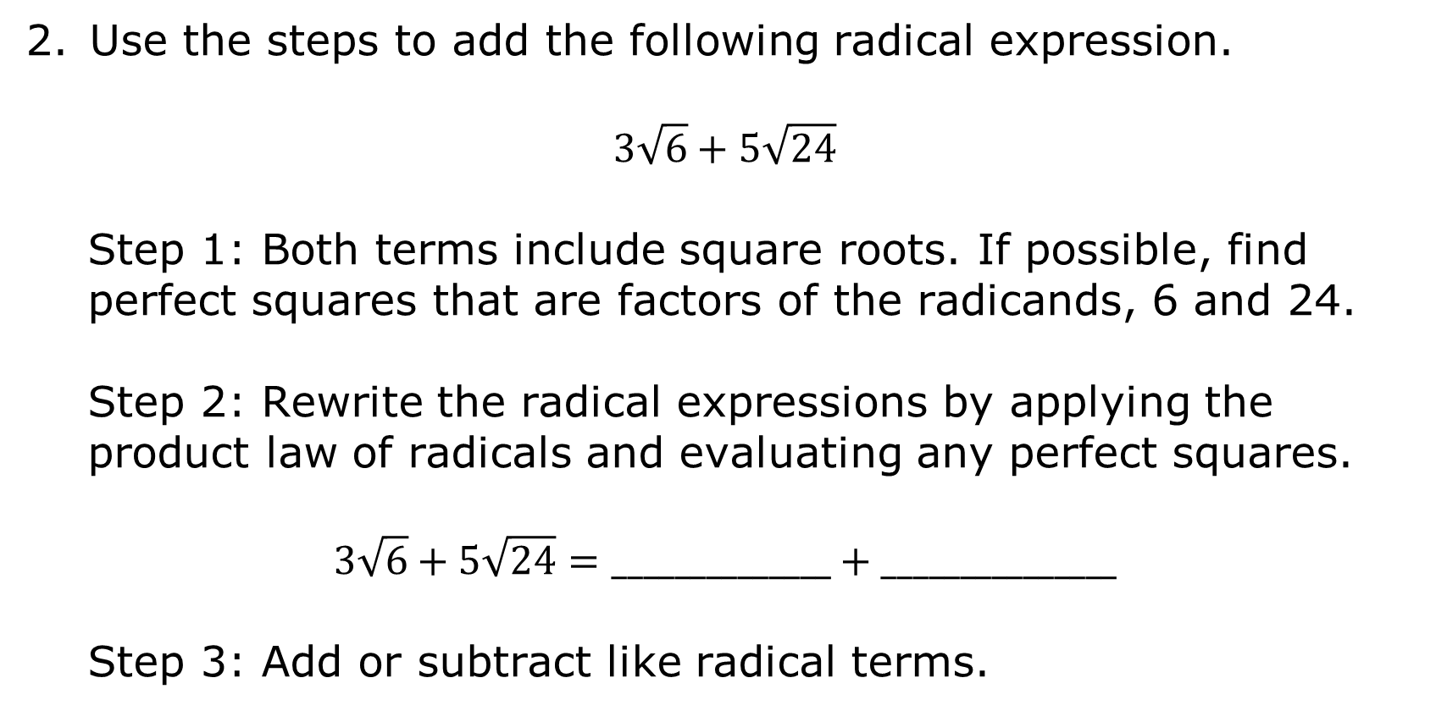
Use the steps to add the following radical expression.
$$3\sqrt{6}+5\sqrt{24}$$
Step 1: Both terms include square roots. If possible, find perfect squares that are factors of the radicands, 6 and 24.
Step 2: Rewrite the radical expressions by applying the product law of radicals and evaluating any perfect squares.
$$3\sqrt{6}+5\sqrt{24}=______________+_______________$$
Step 3: Add or subtract like radical terms.
volume 1, pg. 47

Slide 15

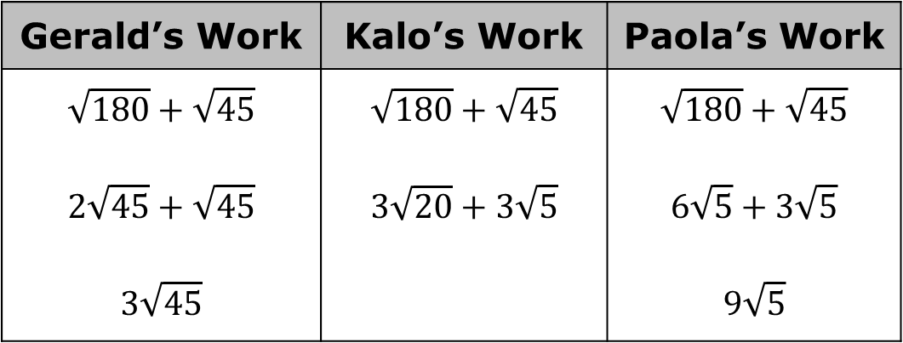
Three students added $\sqrt{180}$ and $\sqrt{45}$ differently. Their work is shown.
Use a calculator to verify if the students’ answers are equivalent.
Gerald’s Work | Kalo’s Work | Paola’s Work
$$\sqrt{180}+\sqrt{45}$$ $$2\sqrt{45}+\sqrt{45}$$ $$3\sqrt{45}$$ | $$\sqrt{180}+\sqrt{45}$$ $$3\sqrt{20}+3\sqrt{5}$$ | $$\sqrt{180}+\sqrt{45}$$ $$6\sqrt{5}+3\sqrt{5}$$ $$9\sqrt{5}$$
volume 1, pg. 47

Slide 16
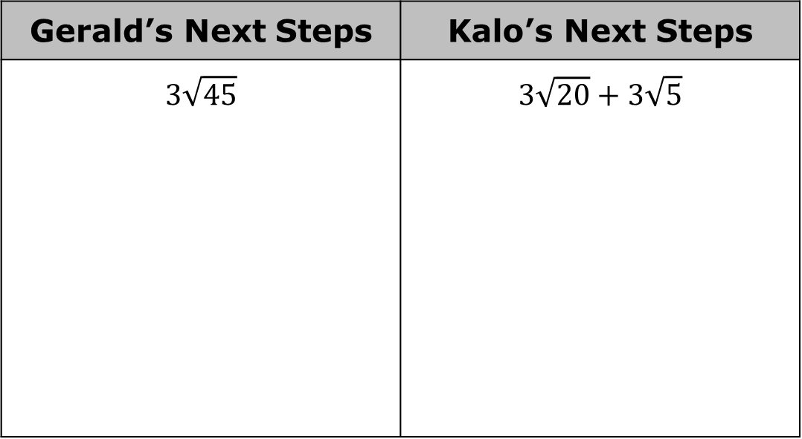
Why did the students end up with different expressions for their sum?
Show how Gerald and Kalo could continue their work to arrive at the same expression as Paola.
Gerald’s Next Steps | Kalo’s Next Steps
$$3\sqrt{45}$$ | $$3\sqrt{20}+3\sqrt{5}$$
volume 1, pg. 47

Slide 17
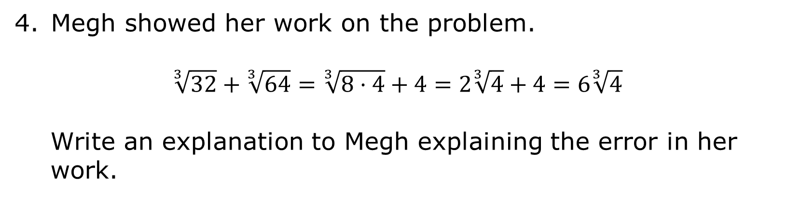
Megh showed her work on the problem.
$$\sqrt[3]{32}+\sqrt[3]{64}=\sqrt[3]{8·4}+4=2\sqrt[3]{4}+4=6\sqrt[3]{4}$$
Write an explanation to Megh explaining the error in her work.
volume 1, pg. 47

Slide 18

Guided Practice
volume 1, pg. 48

Slide 19

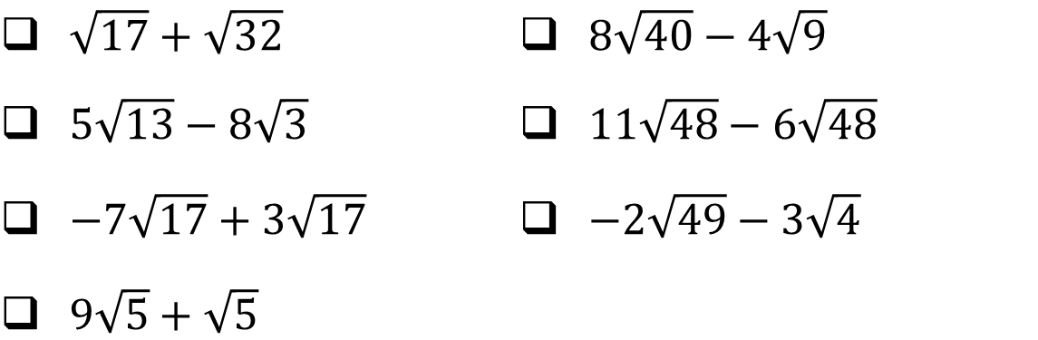
1.9.4 Guided Practice: Adding and Subtracting Radical Expressions
Select all of the expressions that can be combined. For the selected expressions, combine the terms. Show your work.
$\sqrt{17}+\sqrt{32}$ | $8\sqrt{40}−4\sqrt{9}$
$5\sqrt{13}−8\sqrt{3}$ | $11\sqrt{48}−6\sqrt{48}$
$−7\sqrt{17}+3\sqrt{17}$ | $−2\sqrt{49}−3\sqrt{4}$
$9\sqrt{5}+\sqrt{5}$
volume 1, pg. 48

Slide 20
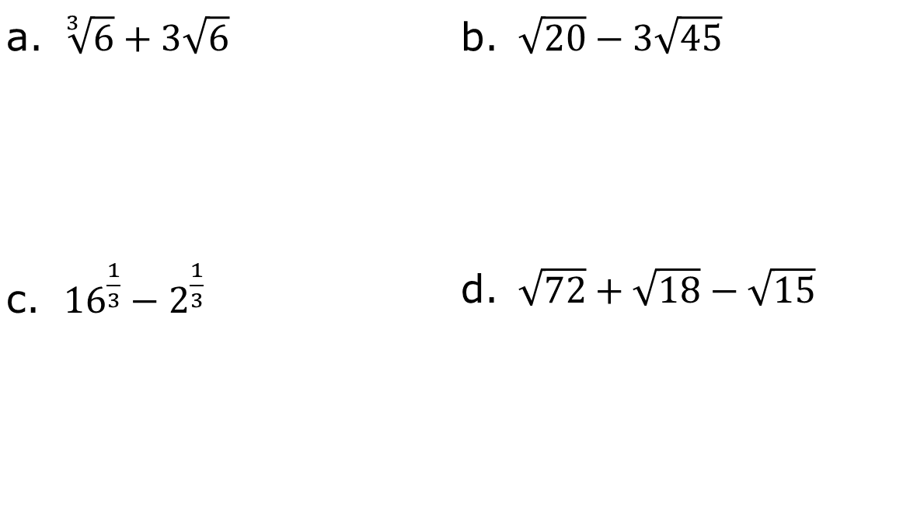
With a partner, find the sum and difference of the following problems. If you cannot add or subtract, circle the expression.
$\sqrt[3]{6}+3\sqrt{6}$ | $\sqrt{20}−3\sqrt{45}$
${16}^{\frac{1}{3}}−2^{\frac{1}{3}}$ | $\sqrt{72}+\sqrt{18}−\sqrt{15}$
volume 1, pg. 48

Slide 21

Your Turn
volume 1, pg. 49

Slide 22

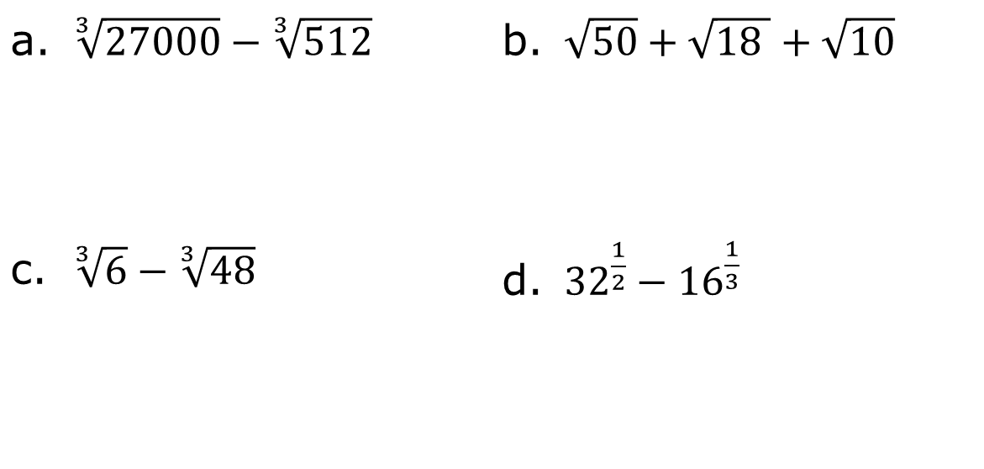
1.9.5 Your Turn!
Find the sum or difference. If you cannot add or subtract, circle the expression.
$\sqrt[3]{27000}−\sqrt[3]{512}$ | $\sqrt{50}+\sqrt{18 }+\sqrt{10}$
$\sqrt[3]{6}−\sqrt[3]{48}$ | ${32}^{\frac{1}{2}}−{16}^{\frac{1}{3}}$
volume 1, pg. 49

Slide 23

Wrap-Up
volume 1, pg. 49

Slide 24
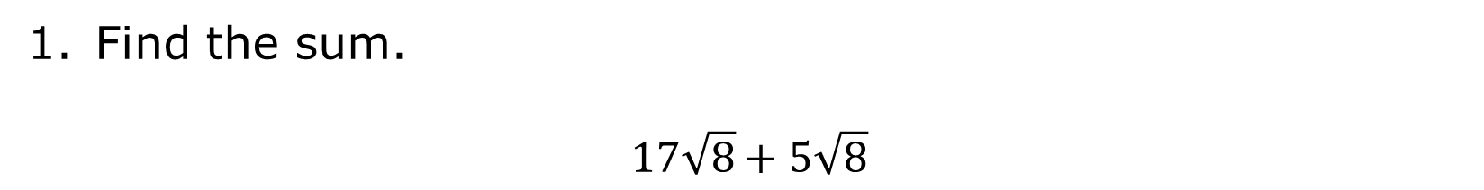
1.9.6 Wrap-Up: Ticket Out the Door
Find the sum.
$$17\sqrt{8}+5\sqrt{8}$$
volume 1, pg. 49

